Slide 1
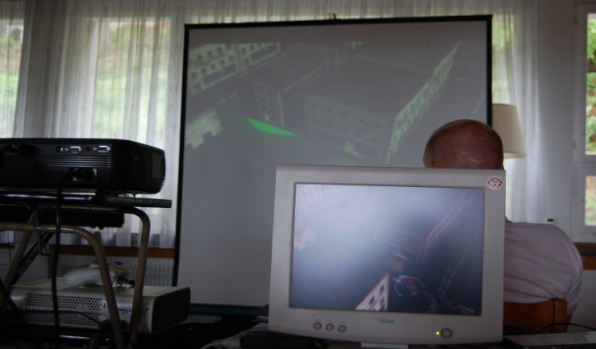
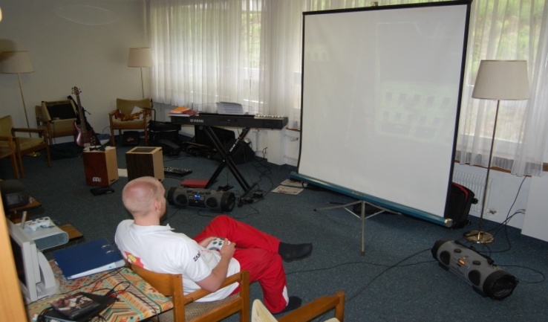
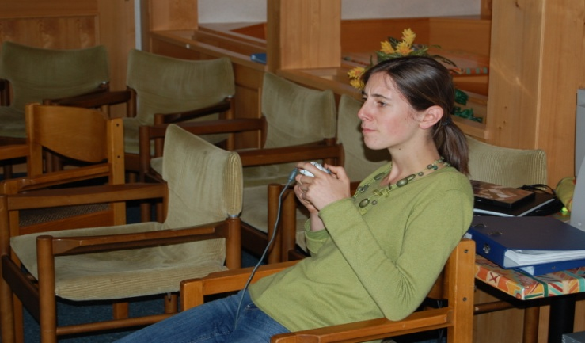
Playtesting

Slide 2
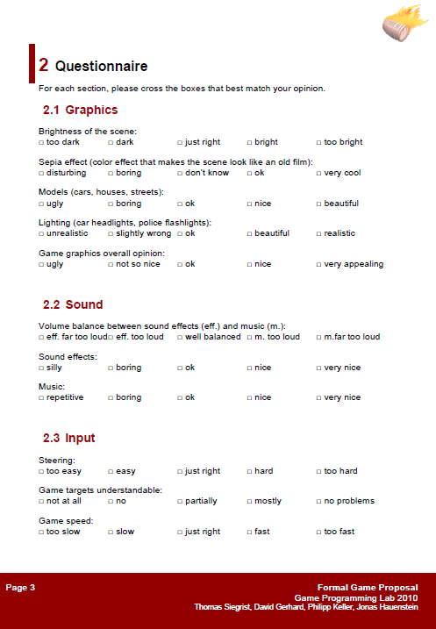
Playtesting Sessions
Three playtesting sessions
Players between 10 and 30 years old
Participants had to fill out Questionnaire and also gave oral Feedback

Slide 3
Graphics
Mostly positive feedback regarding cars and lighting effects
Different people remarked that the overall impression is a bit to monotonous
Possible Improvements:
  Color civilian traffic in the shader
  Color parts of the buildings in the shader

Slide 4
Sound
Background music repetitive or boring
Background music too quiet compared to the effect volume
Possible Improvments:
  Menu entry to adjust sound volumes
  Balancing of the sounds
  Background music still not final

Slide 5
Input
Driving physics proved to be good
„pickup and play“ experience
Ingame player introduction requested
Players confused because of missing progress feedback

Slide 6
AI
General impression of police AI was good
  Do not make them stronger
  Difficulty therefore rated ok
Civilian car AI was rated unequally
Possible Improvements:
  Collision Avoidance System

Slide 7
Drunk‘O‘Meter
Graphical effect commented as „pretty cool“ and „realistic“
Slight effect on steering not noticed by most of the players
Experienced players are drunk quite fast
Unclear why you get drunk

Slide 8
Drunk‘O‘Meter
Possible Improvements:
  Minimal & maximal distance between pickup and delivery
  Reduce drunkeness faster
  Add introduction to loading screen

Slide 9
Conclusion
Acceptance for the game is high
Feedback mostly as expected
Create as much content as possible

