Slide 1


Slide 2
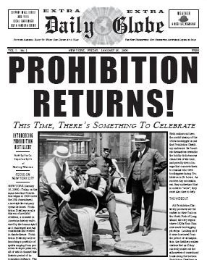
Historical Background
Prohibition in the USA from 1919 to 1933
Alkohol was imported illegally from neighboring countries such as Canada or Mexico.

Slide 3
Basic Game Idea
Different marked spots on the map as delivery points. (Bars, Pubs …)
So called prohibition agents try to stop the smuggling activities.
The Player drives a rack body truck. The truck is loaded with barrels. The barrels are covered by an awning.
Collisions move the awing an uncover the barrels

Slide 4
Basic Game Idea
If the player is beeing chased by the police he still will be able to deliver the alcohol.
A police car chasing the player tries to ram the truck.
Collisions will result in losing parts of your cargo.
If the whole cargo is lost, the police will lose interest in you.

Slide 5
Basic Game Idea
The game starts with a given amount of time on a countdown clock.
The delivery point acts like a checkpoint where the player is rewarded with a time bonus and money.

Slide 6
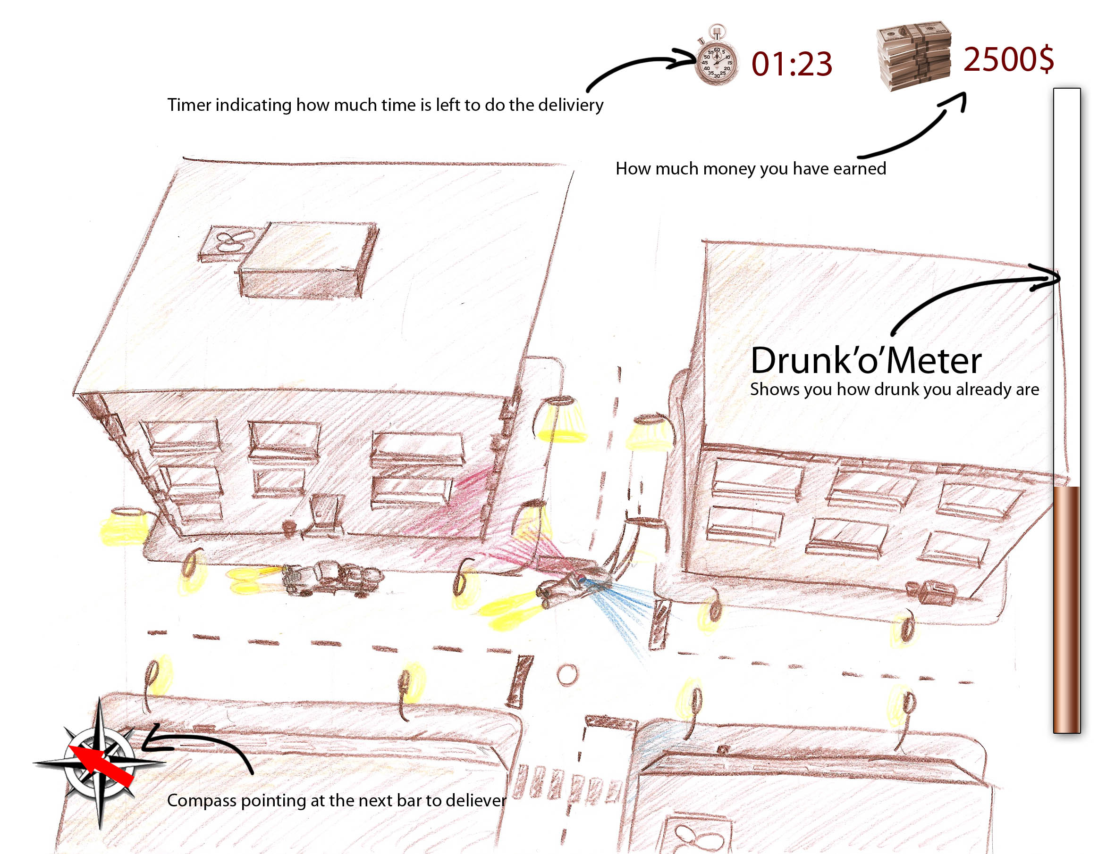
Mockup

Slide 7
Technical Computergraphics Item
Deferred Shading to support multiple light sources.
Fullscreen postprocessing (Sepia effect)

Slide 8
Tools
3D Studio Max to model the cars and buildings
Photoshop to create textures

Slide 9
Development Targets
Functional Minimum
  Basic driving physics of player vehicle
  A basic test map
  Box-based 2D or 3D graphics with simple topdown view
  Basic collision detection
  Basic implementation of game logic (pickup and delivery)
  Some pickup and delivery points on the map
  In short: Something to test / present the most crucial core gameplay

Slide 10
Development Targets
Low target
  A functional guidance system
  Player car model
  Two building models
  Basic 3D graphics with a rudimentary working chasing-camera
  A game map (streets and buildings around it)
  Some basic graphic effects
  Some menu screens (main, pause, scoring)

Slide 11
Development Targets
Desirable target
  Fine tuned driving physics
  Some reasonable physics on collision
  One or more cop-cars with a basic AI
  A basic attention implementation for the cop-cars
  Cop car model
  Enhanced 3D graphics
  Special delivery and pickup buildings
  A fully working camera system with no major drawbacks
  Some sound effects are included
  The game logic is fully implemented (pickup, delivery, countdown, bonustime)

Slide 12
Development Targets
High target
  A well working physics
  Good AI for cop-cars
  A fully functional attention system for cop-cars
  Some advanced graphic effects
  Most events have a sound effect associated to it
  Background music
  Game logic is completely fine tuned
  The graphic should reflect the style of the 30’s

Slide 13
Development Targets
Extras
  More stylized rendering
  Highscore Board
  Multiplayer (Split Screen) with the possibility to interact with the competitor’s car
  Multiplayer LAN Game
  Multiple difficult levels
  Randomly generated maps
  Civilian (NPC) traffic
  “drunk-O-meter”

